Slide 1

Pi-Car Dual System
Autonomous Color Seeker & Visual Inspection Robot

Slide 2



Dual Project Scope
Color Seeker Robot
Visual Inspection
An autonomous tracking system that utilizes hue, saturation, and value (HSV) masking to follow specific color profiles. It employs image moments to calculate the centroid of target objects for real-time motor actuation.
A mobile quality control unit designed to systematically scan components or environments. It captures high-resolution frames, detects visual anomalies, and securely logs the inspection data to the central web dashboard.

Slide 3








Core Architecture
Hardware
Vision Nodes
Web Server
Raspberry Pi acts as the central compute unit, integrating the camera module and motor driver circuits safely.
Dedicated Python scripts (vision_node.py, camera_node.py) execute continuous OpenCV processing streams.
A lightweight Flask application serves the user interface, secure routing, and real-time operational logs.

Slide 4
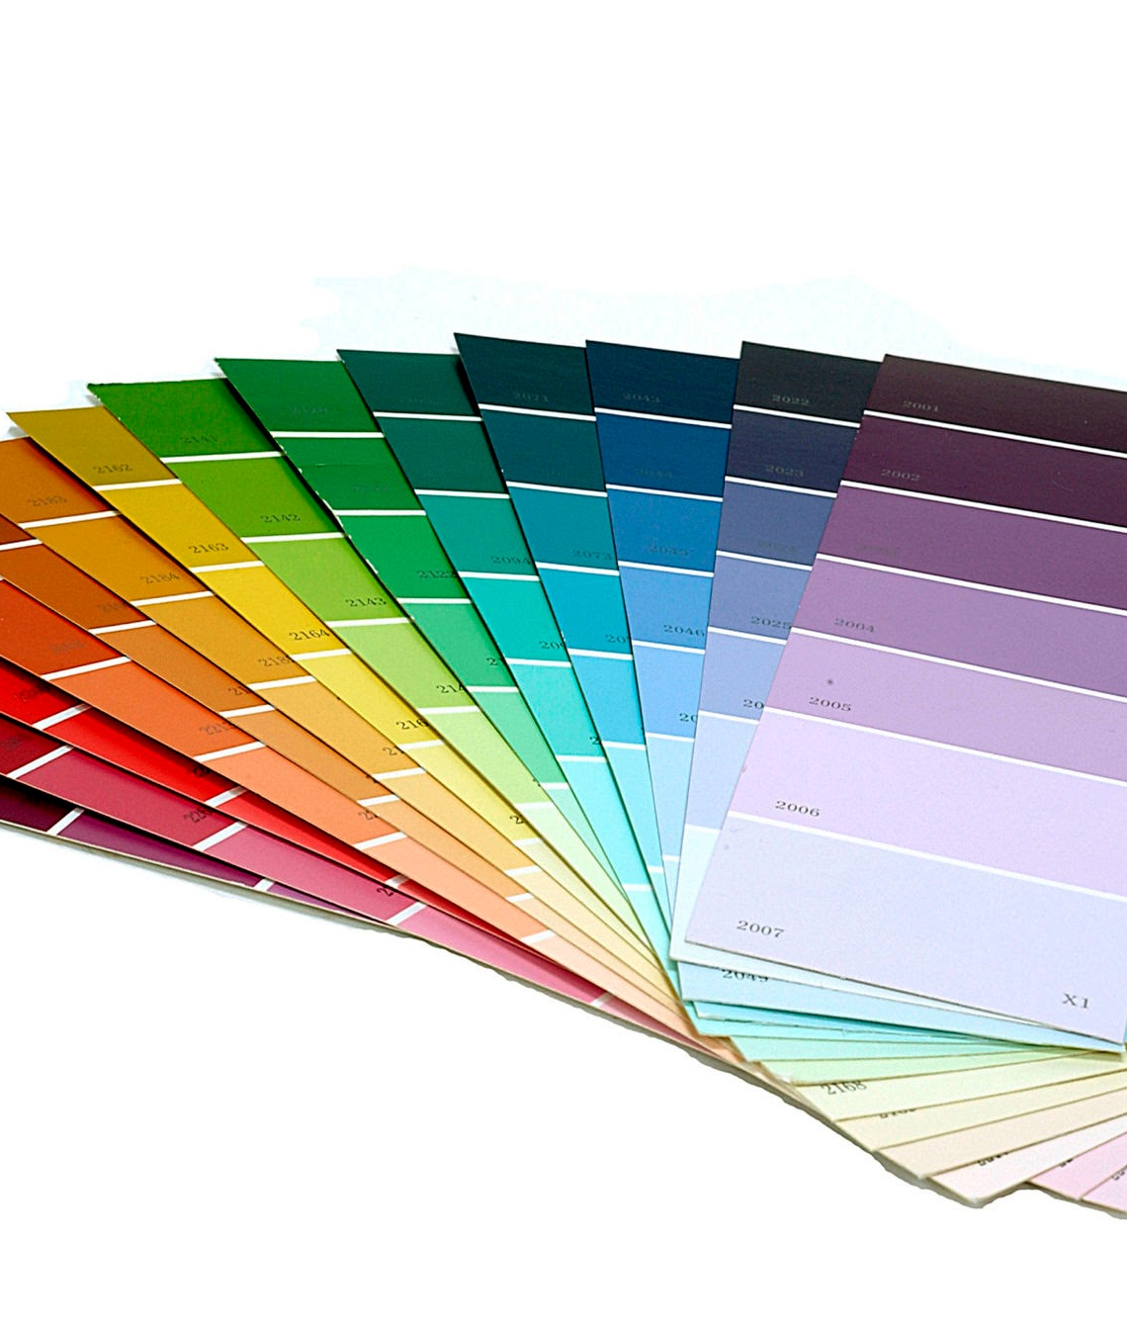
Color Seeker Mode
The Color Seeker module enables the Pi-Car to autonomously identify and pursue specific color signatures. Leveraging real-time OpenCV masking and contour detection, the robot dynamically adjusts motor speeds to center and track the target object seamlessly.

Slide 5





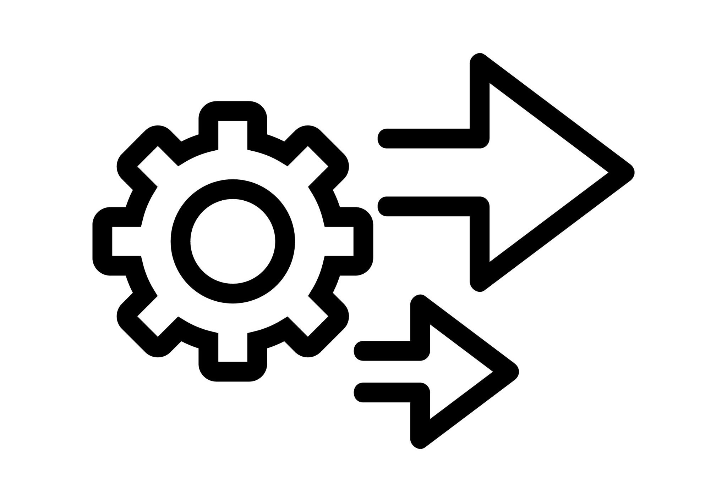
Vision Components
Camera Node: Manages hardware initialization and continuous high-speed frame capture.
Vision Node: Applies spatial filters, thresholding, and contour extraction to live frames.
Actuation: Translates spatial coordinates into pulse-width modulation for motors.

Slide 6

Visual Inspection
The Visual Inspection mode transforms the Pi-Car into a mobile quality control agent. Utilizing high-resolution image capture and OpenCV algorithms, it systematically scans environments to detect anomalies or identify specific items, logging all findings to the dashboard.

Slide 7



Inspection Workflow
Capture: The camera_node initializes the hardware stream and captures high-fidelity RGB frames.
Process: OpenCV applies structural analysis and template matching to identify deviations or target items.
Log: Detection events, timestamps, and confidence scores are recorded to the internal system database.
Display: The Flask application serves these real-time logs to the user interface via the dedicated templates.

Slide 8




Web Dashboard
Flask Backend: Lightweight, robust routing handles all HTTP requests and API endpoints.
Secure Access: Implements user authentication with dedicated login and registration templates.
Mission Control: Users can dynamically switch between Seeker and Inspection operation modes.
Responsive UI: Built with semantic HTML and CSS, optimized for desktop and mobile viewing.

Slide 9
System Uptime
100%
systemd Integration
The Pi-Car leverages a custom systemd service (pi-car.service) to ensure the robot operates completely headless. The web dashboard and all camera/vision nodes automatically launch on boot, resulting in maximum reliability and zero manual intervention.
Automated Startup

Slide 10
Mode Comparison
System Feature | Color Seeker Mode | Visual Inspection Mode
Primary Goal | Dynamic target tracking | Static/Mobile quality analysis
Vision Algorithm | HSV Masking & Contours | Template Matching & Edge Detection
Actuation Method | Continuous Motor Adjustments | Stop-and-Scan or Waypoint Navigation
Data Output | Real-time spatial coordinates | Logged anomaly incident reports

Slide 11
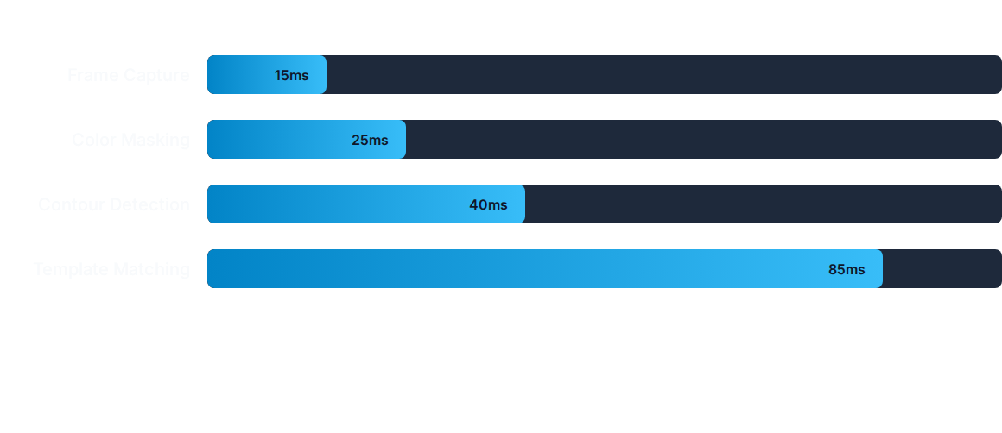
Processing Latency
Average latency metrics (in milliseconds) per frame during active robot operations. The system maintains robust real-time performance across both functional modes.

Slide 12
Questions?
Thank you for exploring the Pi-Car Dual System.
Access the codebase & documentation.

